Slide 1
8. Introduction to Economics

Slide 2
What is Economics?

Slide 3
What is Economics?
A social science that studies and influences human behavior
Economics is the study of what constitutes rational human behavior in the endeavor to fulfill needs and wants.
  “A science that deals with the allocation, or use, of scarce resources for the purpose of fulfilling society’s needs and wants.” – Addison-Wesley

Slide 4
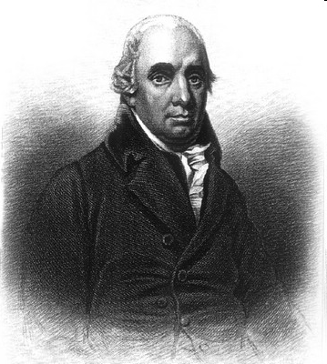
The “Father”
The Foundation of Economics
Adam Smith (1723 - 1790)
  Author of the famous book "An Inquiry into the Nature and Causes of the Wealth of Nations"

Slide 5
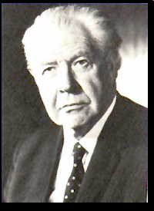
The Foundation of Economics
- Robbins
Scarcity
  Scarcity refers to our limited resources and our unlimited wants and needs.
  For an individual, resources include time, money and skill.
  For a country, limited resources include natural resources, capital, labour force and technology.

Slide 6
ECONOMICS
MICRO
MACRO

Slide 7
Micro Economics
Micro Economics studies how the individual parts of the economy make decisions to allocate limited resources
Microeconomics studies:
  how individuals use limited resources to meet unlimited needs
  the consequences of their decisions
  the behaviour of individual components like industries, firms and households.
  how individual prices are set
  what determines the price of land, labour and capital
  inquire into the strengths and weaknesses of the market mechanism.

Slide 8
Macro Economics
Macroeconomics studies about the functioning of the economy as a whole
It examines the economy through wide-lens.
Macroeconomics studies about
  the total output of a nation
  the way the nation allocates its limited resources of land, labor and capital
  the ways to maximize production levels
  the techniques to promote trade
After observing the society as a whole, Adam Smith noted that there was an "invisible hand" turning the wheels of the economy: a market force that keeps the economy functioning.

Slide 9
The Factors of Production
Land
Labor
Capital
Entreprenship

Slide 10
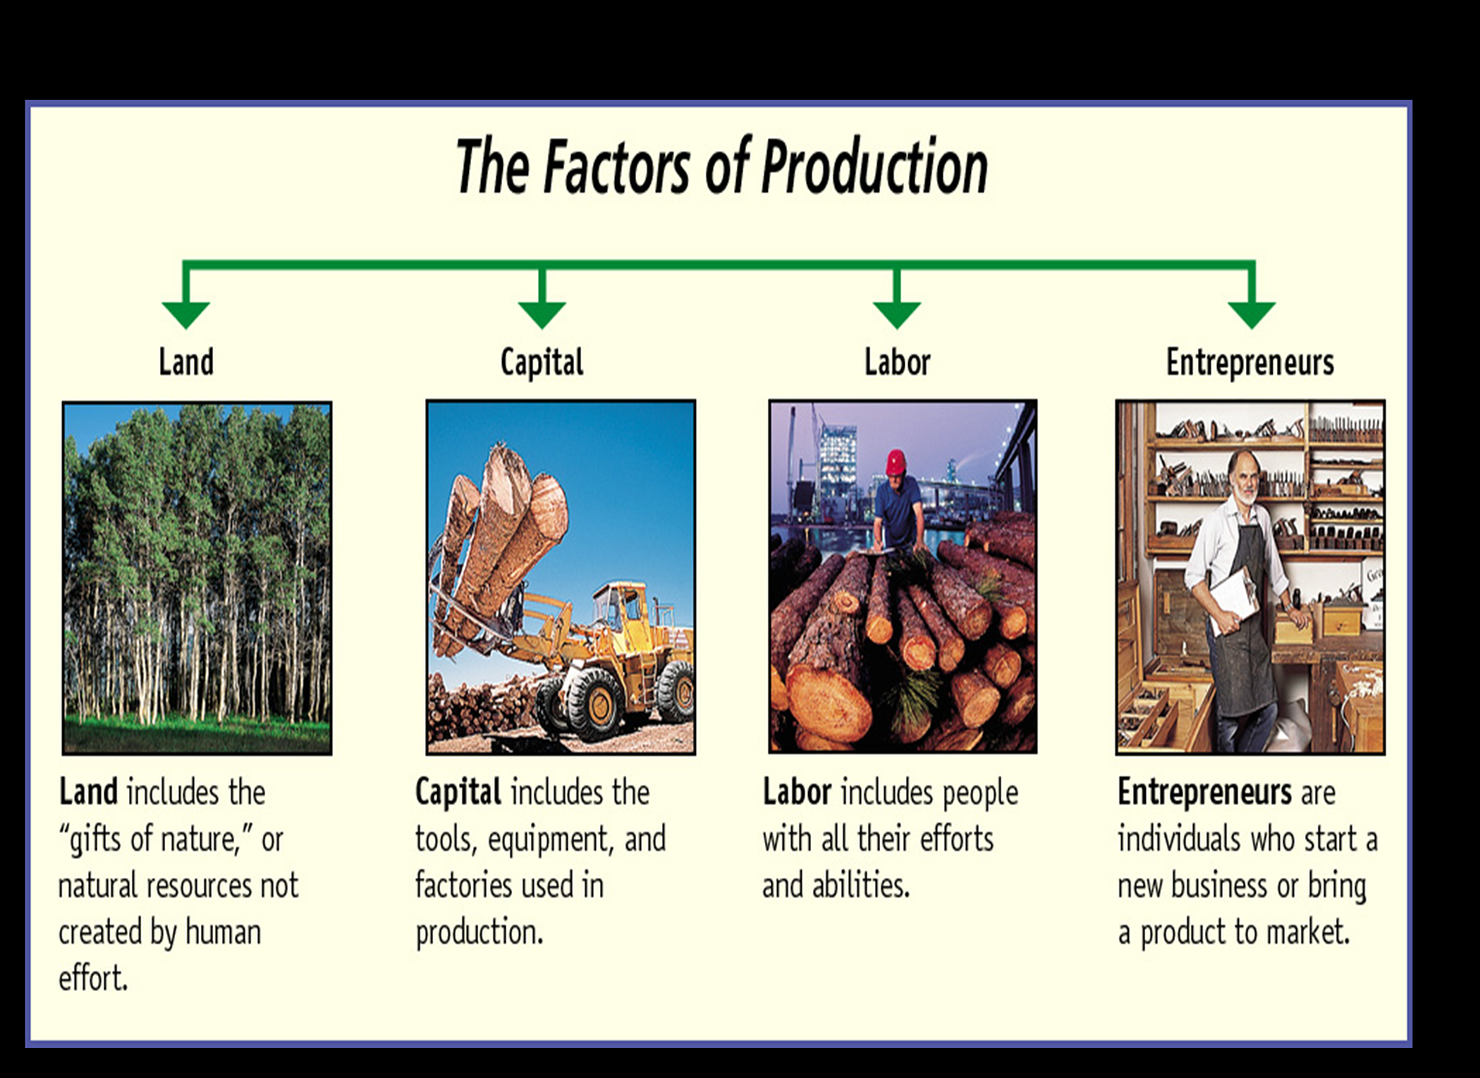
The Factors of Production

Slide 11


Need and Want
A need is something you have to have, something you can't do without.
  A good example is food. If you don't eat, you won't survive for long. Many people have gone days without eating, but they eventually ate a lot of food. You might not need a whole lot of food, but you do need to eat.
A want is something you would like to have. It is not absolutely necessary, but it would be a good thing to have.
  A good example is music. Now, some people might argue that music is a need because they think they can't do without it. But you don't need music to survive. You do need to eat.

Slide 12
Scarcity
Definition
  A situation in which the amount of something actually available would not be sufficient to satisfy the desire for it, if it were provided free of charge.

Slide 13
The Economic Problem
Unlimited Wants
Scarce Resources – Land, Labour, Capital
Many Uses of Resources
Choices

Slide 14
The Economic Problem
What goods and services should an economy produce?
– should the emphasis be on agriculture, manufacturing or services, should it be on sport and leisure or housing?
How should goods and services be produced? – labour intensive, capital intensive?
Who should get the goods and services produced? – Even distribution? More for the rich? For those who work hard?

Slide 15
Opportunity Cost
Definition – the cost expressed in terms of the next best alternative sacrificed
The cost of anything in terms of other things given up or sacrificed.

Slide 16
Production Possibility Frontiers/Curve
PPF Shows the different combinations of goods and services that can be produced with a given amount of resources
No ‘ideal’ point on the curve
Any point inside the curve – suggests resources are not being utilised efficiently
Any point outside the curve – not attainable with the current level of resources
Useful to demonstrate economic growth and opportunity cost

Slide 17
Production Possibility Frontiers
If it reallocates its resources (moving round the PPF from A to B) it can produce more consumer goods but only at the expense of fewer capital goods. The opportunity cost of producing an extra Xo – X1 consumer goods is Yo – Y1 capital goods.
Capital Goods
If the country is at point A on the PPF It can produce the combination of Yo capital goods and Xo consumer goods
Ym
Yo
A
B
Y1
Xo
X1
Xm
Consumer Goods

Slide 18
Production Possibility Frontiers
Capital Goods
If the country is at point A on the PPF It can produce the combination of Yo capital goods and Xo consumer goods
Ym
Yo
A
Xo
Xm
Consumer Goods

Slide 19
Production Possibility Frontiers
If it reallocates its resources (moving round the PPF from A to B) it can produce more consumer goods but only at the expense of fewer capital goods. The opportunity cost of producing an extra Xo – X1 consumer goods is Yo – Y1 capital goods.
Capital Goods
Ym
Yo
A
B
Y1
Xo
X1
Xm
Consumer Goods

Slide 20
Production Possibility Frontiers
It can only produce at points outside the PPF if it finds a way of expanding its resources or improves the productivity of those resources it already has. This will push the PPF further outwards.
Production inside the PPF – e.g. point B means the country is not using all its resources
Capital Goods
C
Y1
Yo
.B
A
Xo
X1
Consumer Goods

Slide 21
Production Possibility Frontiers
Production inside the PPF – e.g. point B means the country is not using all its resources
Capital Goods
Yo
.B
A
Xo
Consumer Goods

Slide 22
Production Possibility Frontiers
It can only produce at points outside the PPF if it finds a way of expanding its resources or improves the productivity of those resources it already has. This will push the PPF further outwards.
Capital Goods
C
Y1
Yo
A
Xo
X1
Consumer Goods

